Slide 1

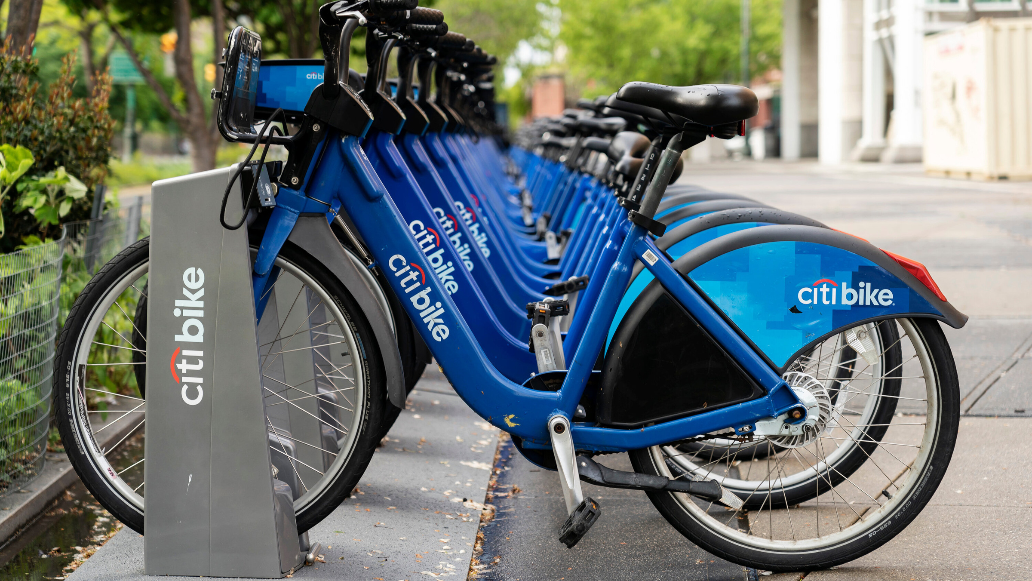


DATA ANALYSIS
Citi Bike Dataset
An In-Depth Exploration of Ridership Trends
SUBHASH KOLI
AMAN SINGH
SUMIT VISHWAKARMA

Slide 2




About Company
What is Citi Bike?
Objective of this Analysis:
Understand who uses Citi Bike (Subscribers vs. One-time Users).
Examine how weather & seasons impact ridership.
Identify key insights to improve Citi Bike operations & user experience.
New York City’s largest bike-sharing system.
Offers accessibility to casual users & subscribers.
03/10

Slide 3

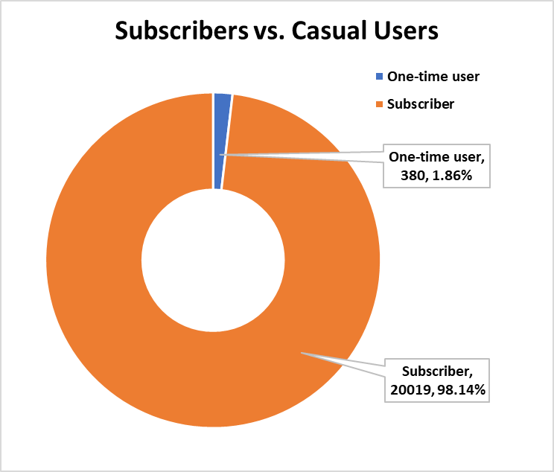
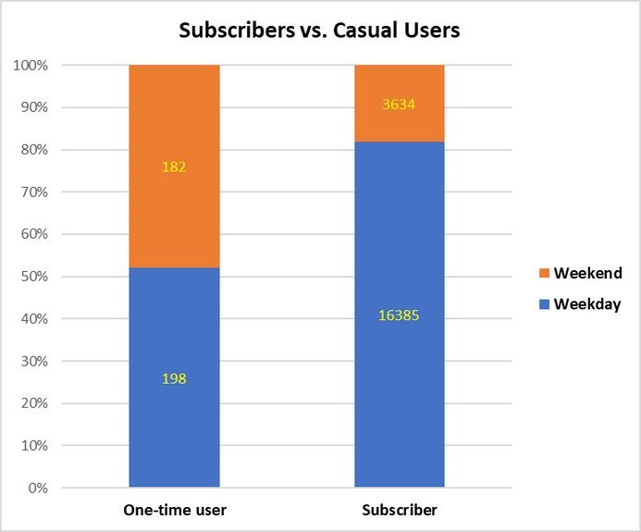
Subscribers vs. Casual Users
Data Overview:
98.14% of trips are made by Subscribers.
Only 1.86% of trips are from One-time Users.
Recommendations:
Introduce promotions for casual users to increase adoption.
Offer subscription trials to convert one-time users.

Slide 4

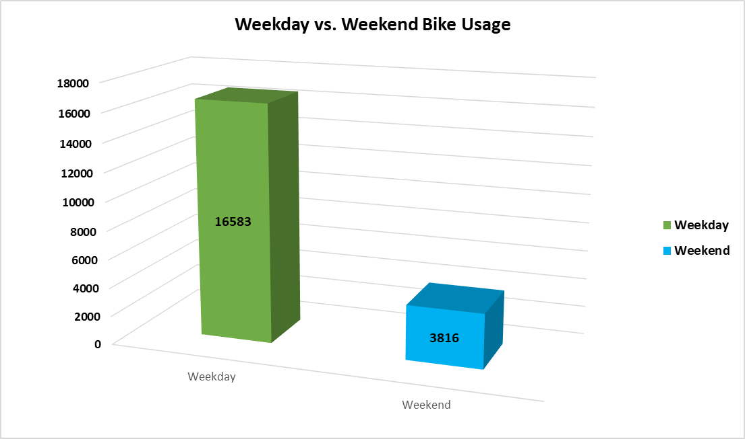
Weekday vs. Weekend Trends
Data Findings:
Subscribers: 16,385 trips (Weekday), 3,634 trips (Weekend).
One-time users: 198 trips (Weekday), 182 trips (Weekend).
Insights:
Subscribers use Citi Bike for commuting, with peak usage on weekdays.
One-time users have a balanced weekday-weekend split.
Actionable Steps:
Improve weekday availability of bikes at major transit hubs.
Launch weekend tourist packages to attract more one-time users.

Slide 5
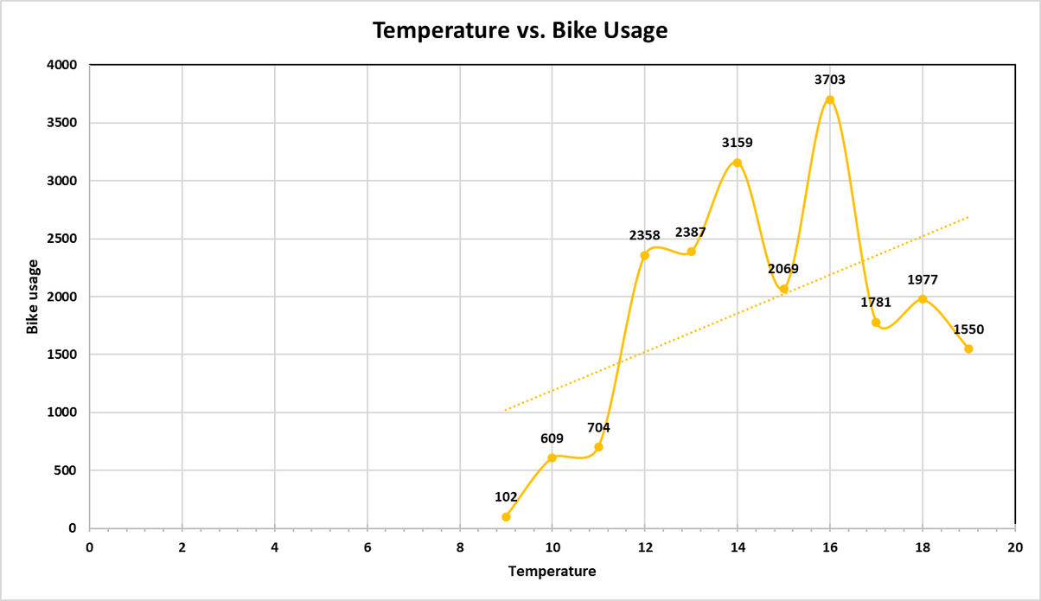

Impact of Temperature on Bike Usage
Data Trends:
Bike usage peaks at 16°C (3,703 trips).
Sharp decline below 10°C and above 18°C.
Key Takeaways:
Moderate weather (12-16°C) sees the highest bike usage.
Extremes (too cold or too hot) reduce ridership.
Business Implications:
Promote biking on moderate temperature days.
Introduce cold-weather biking campaigns to encourage winter usage.

Slide 6

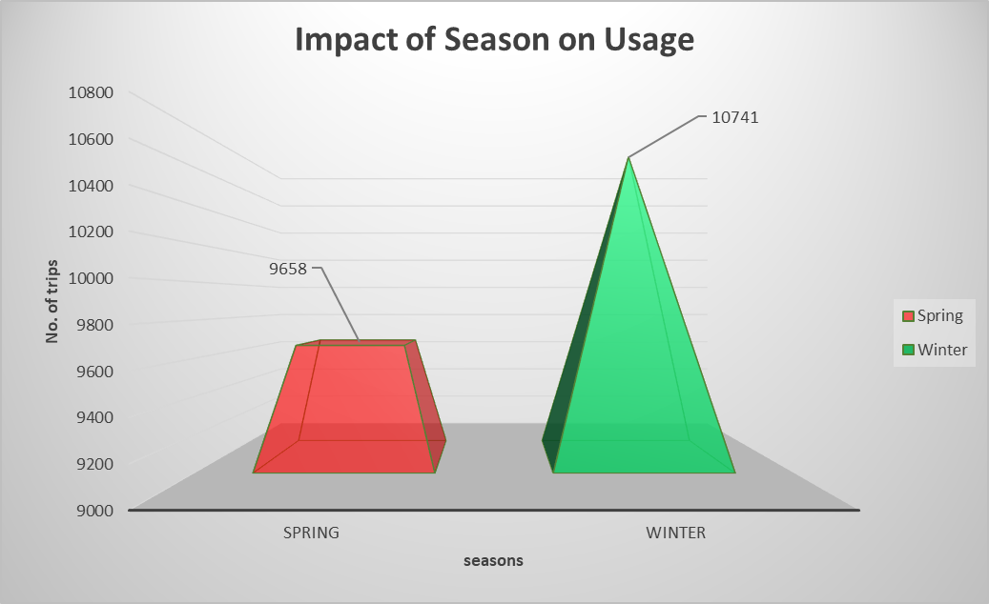
Impact of Seasons on Bike Usage
Spring vs. Winter Analysis:
Winter: 10,741 trips (Higher than expected!)
Spring: 9,658 trips
Why is Winter higher than Spring?
More commuters using bikes in Winter.
Spring has more transportation alternatives (walking, jogging).
Action Points:
Offer Spring discounts to boost ridership.
Introduce Winter biking safety campaigns.

Slide 7
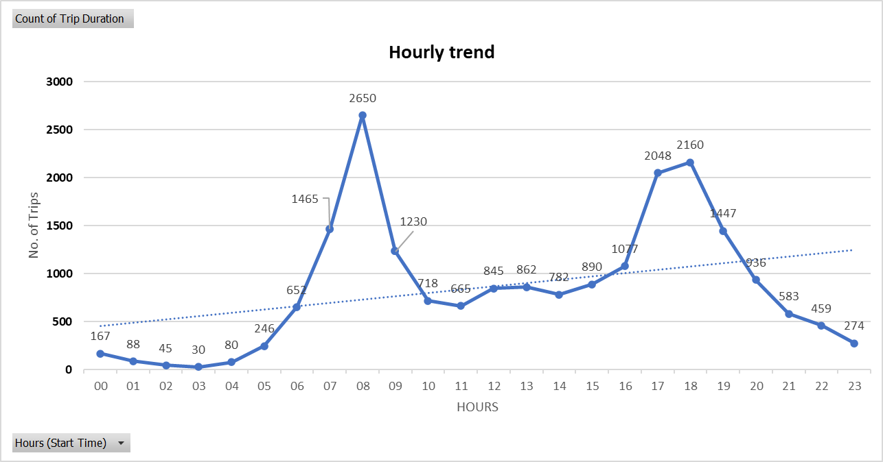
Hourly Trend of Citi Bike Usage:
Peak Hours:
Morning: 7:30 AM – 9:30 AM (Commute to work).
Evening: 5:00 PM – 7:30 PM (Return commute).
Key Actions:
Increase bike availability during rush hours.
Dynamic pricing models for peak demand.

Slide 8
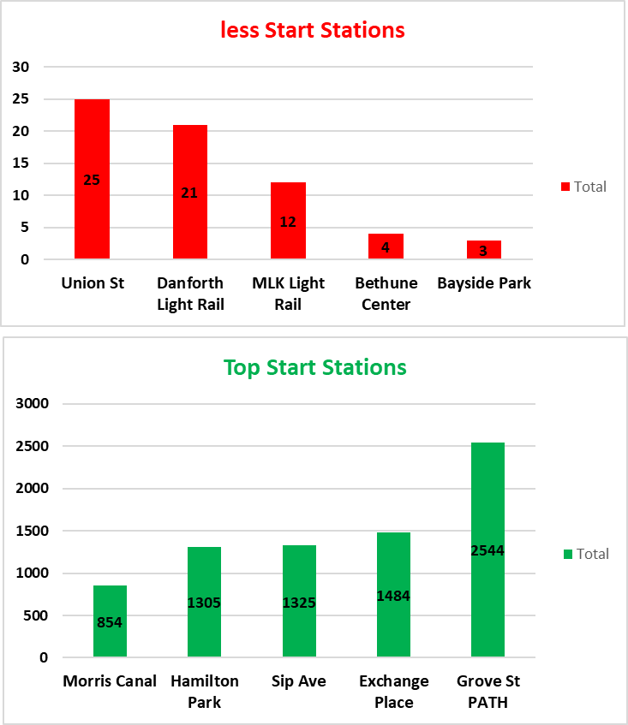
Most & Least Used Start Stations:
Less Popular Start Stations (Red Graph)
Union St – 25 trips
Danforth Light Rail – 21 trips
Possible reasons: Low residential density, fewer commuters, lack of connectivity.
Most Popular Start Stations (Green Graph)
Grove St PATH – 2544 trips
Exchange Place – 1484 trips
Possible reasons: Proximity to transit hubs, high foot traffic, commuter demand

Slide 9
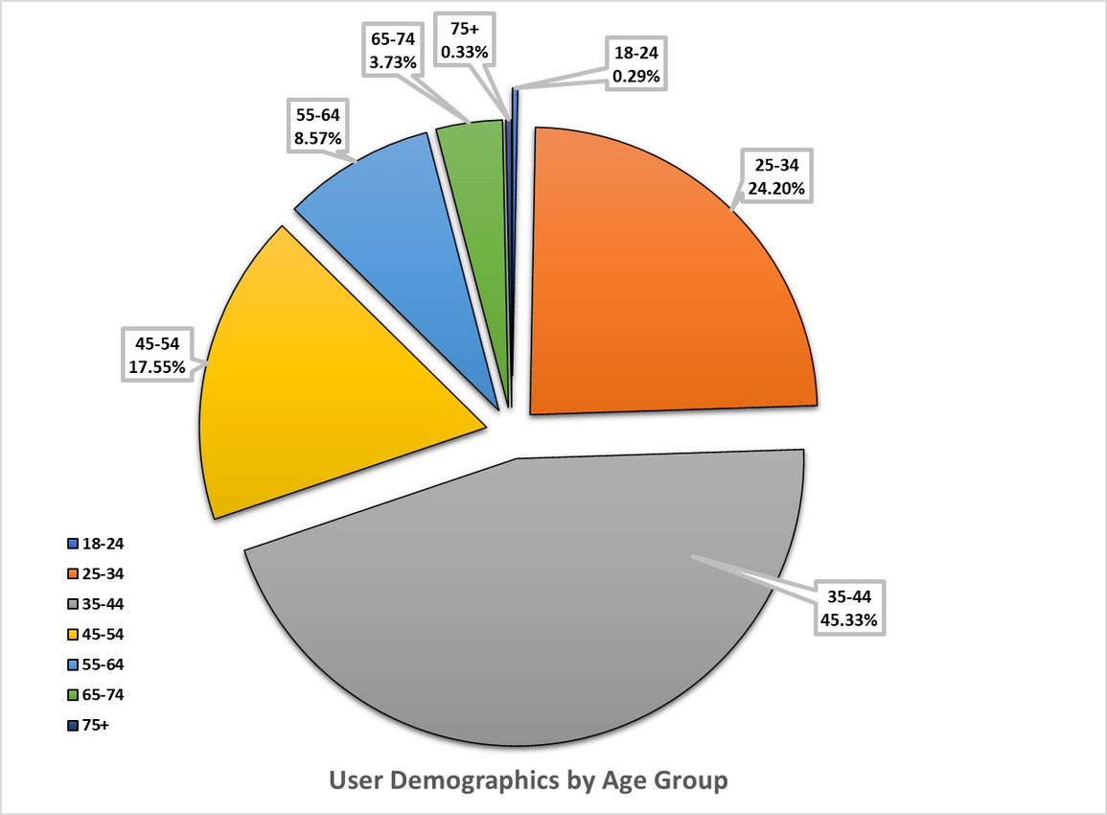
Breakdown of Users:
Age Group Distribution:
Majority of riders: 25-34 years old.
Fewer riders: Under 18 & 55+.
Targeted Strategies:
Youth promotions (college student discounts).
Senior-friendly biking initiatives (easier bike access, comfort upgrades).

Slide 10


Citi Bike Station Analysis
Boost One-time User Engagement:
Weekend packages, better advertising.
Weather-based Strategies:
Seasonal discounts, bike-friendly winter gear.
Enhance Commuter Experience:
Expand stations, loyalty programs

Slide 11

THANK
YOU.

